Slide 1
Using similar code to program repair
2020/01/15
Ju Hyoung Kim

Slide 2
〮 last week work
Checking multiline compatible problem -> Some research but not active
To reduce overfitting,
Use Code similarity -> repair ingredients using code similarity
reusing, redundant code check with code similarity

Slide 3
〮 Related work
Deep Learning Similarities from Different Representations of Source Code
(MSR '18: Proceedings of the 15th International Conference on Mining Software Repositories)
Learn code similarities from different representations, such as streams of identifiers, AST nodes, bytecod,CFGs.
Combined models can be automatically assembled to consider multiple representations for SE tasks.

Slide 4
〮 Related work
- Sorting and Transforming Program Repair Ingredients via Deep Learning Code Similarities
(Proceedings 26th IEEE International Conference on Software Analysis, Evolution and Reengineering (SANER 2019))
- These approaches are based on redundancy based repair techniques, they leverage redundancy and repetition in source code
- selects ingredients from similar methods or classes where similarity has been inferred with deep unsupervised learning

Slide 5
〮 Related work
Harnessing Evolution for Multi-Hunk Program Repair
(ICSE '19: Proceedings of the 41st International Conference on Software Engineering)
Detecting and using code clone
Multi hunk patches
sets of repair locations as evolutionary siblings – similar looking code, instantiated in similar contexts, that are expected to undergo similar changes

Slide 6
〮 Related work
Automated Program Repair by Using Similar Code Containing Fix Ingredients
2016 IEEE 40th Annual Computer Software and Applications Conference (COMPSAC)
to propose reusability metrics of similar code fragments for program repair

Slide 7
On Learning Meaningful Code Changes via Neural Machine Translation
Michele Tufano∗, Jevgenija Pantiuchina†, Cody Watson∗, Gabriele Bavota†, Denys Poshyvanyk∗
2019 IEEE/ACM 41st International Conference on Software Engineering (ICSE)

Slide 8
〮 Introduction
Vast availability of data(open source repository)
Deep Learning -> useful tool (Neural Machine Translation)
Still a lack of empirical evidence about the types of code changes
In this paper, check how to automatically apply code changes as developers do.
With before (PR not submitted) and after (PR merged)
RNN is used to learn the code transformation
Demonstrate a quantitative and qualitative evaluation
(assessed its ability in modifying the project`s code exactly)
(distill a taxonomy of meaningful code transformation)

Slide 9
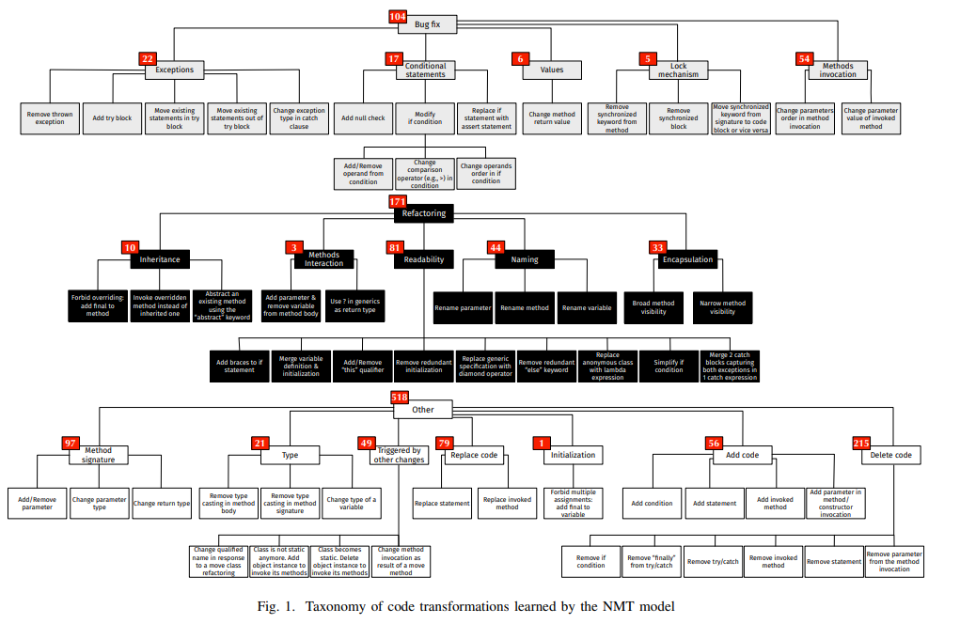

Slide 10
〮 Future Plan
Read above papers and arrangement their characteristics more accurately
How apply these feature to the model?

